Slide 1
Introduction to .Net MAUI
John DeVries

Slide 2
Quick Review of C#

Slide 3
C# Language – Built-in keywords
Branching
If, else if, else
Switch
Iteration
For
While
For each
Actions
Methods
Access Modifiers
Public, private, internal
Data type
Void
Return
Classes
New
Static

Slide 4
C# Primitive Data Types
Built-in data types
Bool
Int
Float, double
Char
String
…
Where do they come from?
From the system class library
.NET API browser | Microsoft Learn

Slide 5
C# Custom Data Types
Typically complex data types are:
Defined by a Class (pretend structs are same as a class)
Package includes more than one piece of information

Slide 6
Typical Custom Data Type
public class UserInfoType
{
public int Id { get;set; }
public string Username { get; set; }
public string FirstName { get; set; }
public string LastName { get; set; }
public string AddressLine1 { get; set; }
public string AddressLine2 { get; set; }
public string AddressLine3 { get; set; }
public string AddressLine4 { get; set; }
public string City { get; set; }
public string Region { get; set; }
public string Country { get; set; }
public string HomePhone { get; set; }
public string WorkPhone { get; set; }
public string MobilePhone { get; set; }
public string PersonalEmail { get; set; }
public string WorkEmail { get; set; }
public string Notes { get; set; }
}

Slide 7
Passing data to a method using variables
public void UpdateUserInfo(int id, string username, string firstName, string lastName, string addressLine1, string addressLine2, string addressLine3, string addressLine3, string addressLine4, string city, string postcode, string region, string country, string homePhone, string workPhone, string mobilePhone, string personalEmail, string workEmail, string notes)
{
// ### implementation omitted ###
}

Slide 8
Custom Data Types - Packages
public void UpdateUserInfo(UserInfoType userInfo)
{
// ### implementation omitted ###
}
Access using dot notation
UserInfo.Id
UserInfo.UserName
…

Slide 9
Class Design
Vet Practice App
Class Animal
Class Appointment
Action | Class | Method
Register new owner | Owner | CreateNewOwner
Assign a vet to a pet (optional) | Pet | AssignVet
Register pet | Pet | RegisterPet
Make an appointment | Appointment | CreateAppt
Cancel appointment | Appointment | CancelAppt
Change appointment | Appointment | ChangeAppt
Make pet inactive | Pet | MakeInactive
properties
properties
Methods
Constructor
RegisterPet
AssignVet
Methods
Constructor
CreateAppt
CancelAppt
ChangeAppt
Class
Vet
Class
Owner
properties
properties
Methods
Constructor
Methods
Constructor
CreatNewOwner

Slide 10
Typical Class
Class Properties
Complex Data Type
Class Animal
{
int AnimalId
int OwnerId
string PetName
char Gender
datetime DoB
string FoodType
int AmountOfFood
string BloodType
list Medications[]
string Species
float Height
float Weight
bool Spayed/Neutered
}

Slide 11

Instantiating a Class
Complex data type
variable
constructor
CreditCourse creditCourse = new CreditCourse();
or var
or creditCourse1
or foo
Specify data type
Of variable
Assign to
variable
Creates a new instance of class (object)

Slide 12
3 Syntaxes to Instantiate a Class
1.
CreditCourse myCreditCourse = new CreditCourse();
2.
var myCreditCourse = new CreditCourse();
3.
CreditCourse myCreditCourse = new() ;

Slide 13
Varieties of Classes
Classes that contain only Properties
Called a Model Class
Define our custom data types
Correspond to persisted data
Classes that contain only methods
Usually called a Class Library
Purpose is reusable code
Classes that contain a mix of both
Depends on the purpose of the properties in the class
Utility classes – for local, internal use in app

Slide 14
MAUI
Multi-Application User Interface

Slide 15
Three Levels of .Net MAUI
.Net MAUI can be written using 3 different frameworks:
Basic .Net MAUI
.Net MAUI using MVVM
.Net MAUI using the MVVM Community Toolkit

Slide 16
Three Levels of .Net MAUI
.Net MAUI can be written using 3 different frameworks:
Basic .Net MAUI
.Net MAUI using MVVM
.Net MAUI using the MVVM Community Toolkit

Slide 17
Quick Intro to MVVM

Slide 18
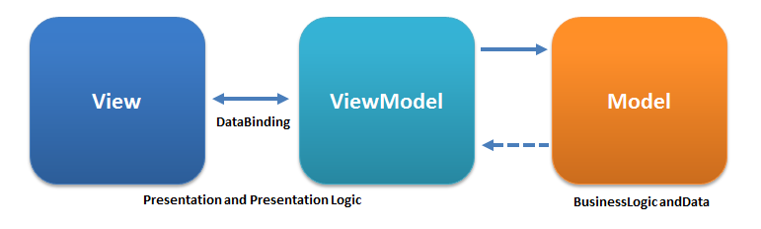
MVVM Pattern – as usually shown
Conceptually correct, but misleading about implementation

Slide 19
Model Classes in MVVM
Blueprints for POCO (Plain Old CLR) objects
Packages of primarily properties
May include some methods
Definitions of custom data types
Model View ViewModel

Slide 20
MVVM Pattern – as usually shown
Conceptually correct, but misleading about implementation

Slide 21
Accurate MVVM Diagram
ViewModel
View
Models
Models
Models
Data Binding
Incorporates:
ViewModel is often referred to as a WRAPPER class

Slide 22
Why ViewModels
Model classes often do not organize properties the way we ant to use them in a view
ViewModels reorganize the same properties to match a view
Auto Parts Store Analogy

Slide 23
Setting up a .Net Maui Project
Create a .Net MAUI project
Add folders for:
View
Model
Move existing Views (e.g. MainPage) into Views folder
Update namespaces on View files, so that added files will be in same namespace
Proceed by adding Models and Views (Pages) in appropriate folder
Add “using” directives for Model and ViewModel folders as needed

Slide 24
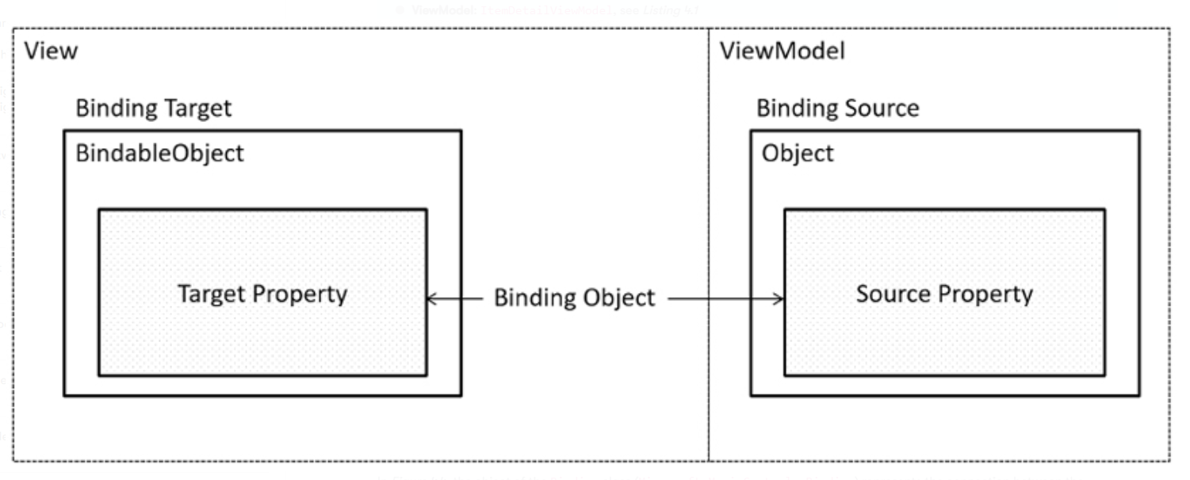
Data Binding Detail
Target – This is the UI element involved and this UI element has to be a child of BindableObject. The UI element used in ItemDetailPage is Label.
Target property – This is the property of the target object. It is a BindableProperty. If the target is Label, as we mentioned here, the target property can be the Text property of Label.
Source – This is the source object referenced by data binding. It is ItemDetailViewModel here.
Source object value path – This is the path to the value in the source object. Here, the path is a ViewModel property, such as Name or Description.

Slide 25
ViewModel vs Code-Behind
Where should I put my code?
Lots of options, no absolute right answer
Recommendations:
“Initialize Component” call must be in Code-Behind
Set Binding Context in Code-Behind

Slide 26
Build mobile and desktop apps with .NET MAUI - Training | Microsoft Learn
.Net MAUI Basics

Slide 27
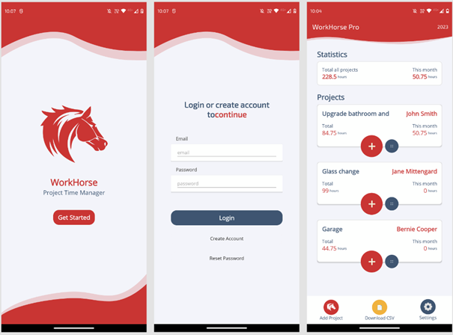
Typical MAUI App

Slide 28
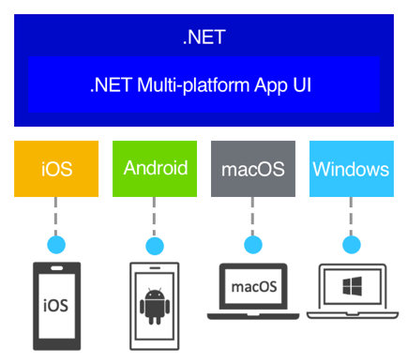
MAUI is Cross Platform for Desktop and Mobile

Slide 29
Elements of .Net MAUI apps
Views
Similar to WinForms Views
Written in XAML
No Visual Designer
Everything is built in code.
Code-Behind Pages
One attached to each View
Default location for event handlers

Slide 30
Creating Views in .Net MAUI

Slide 31
MAUI Controls (sometimes called Views)
XAML – eXtensible Application Markup Language
XML format
Was also used in .Net Window Presentation Foundation (WPF)
Get started with .NET MAUI XAML - .NET MAUI | Microsoft Learn
Typical elements:
Images
Labels
Buttons
ImageButtons
Text
Entry – single line
Editor – multiple lines
https://learn.microsoft.com/en-us/dotnet/maui/xaml/?view=net-maui-8.0

Slide 32
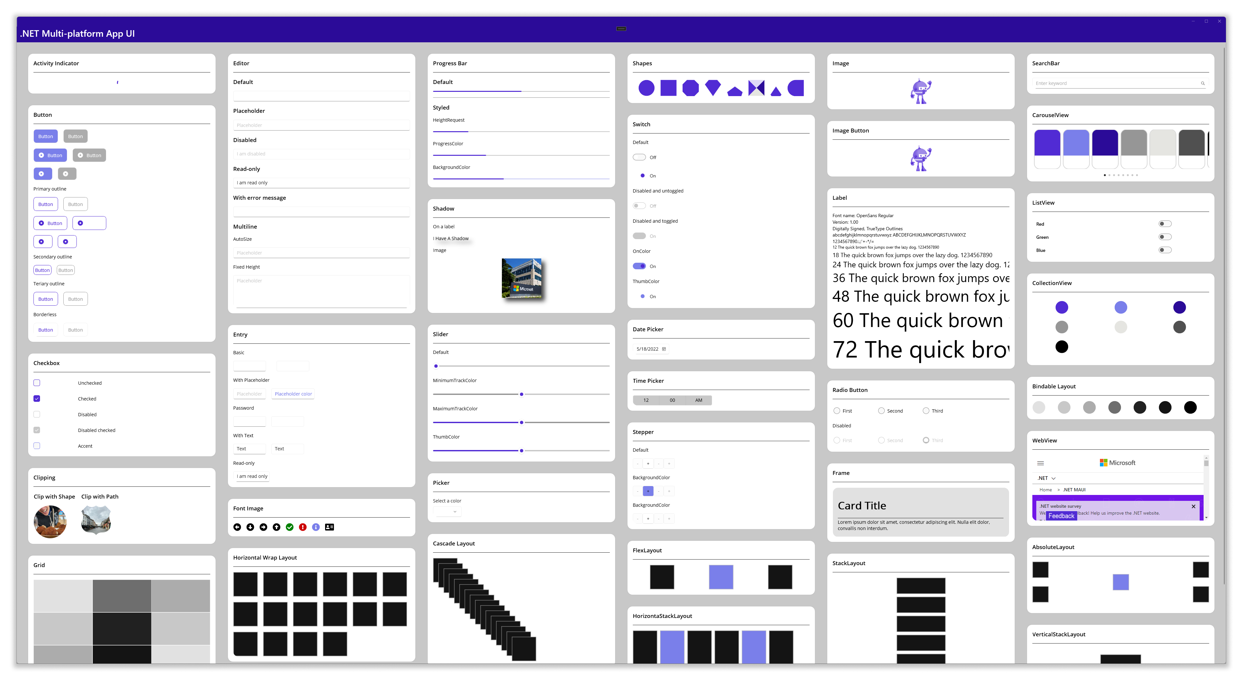
Typical Controls
https://learn.microsoft.com/en-us/dotnet/maui/user-interface/controls/?view=net-maui-8.0

Slide 33
Brushes – Styling in XAML
Solid
Linear Gradient
Radial Gradient

Slide 34
Event Handling in .Net MAUI

Slide 35
Event-Driven Programming
Event Generator “fires” event
Event Listener “catches” event
Event Handler is launched to do something in response to event

Slide 36

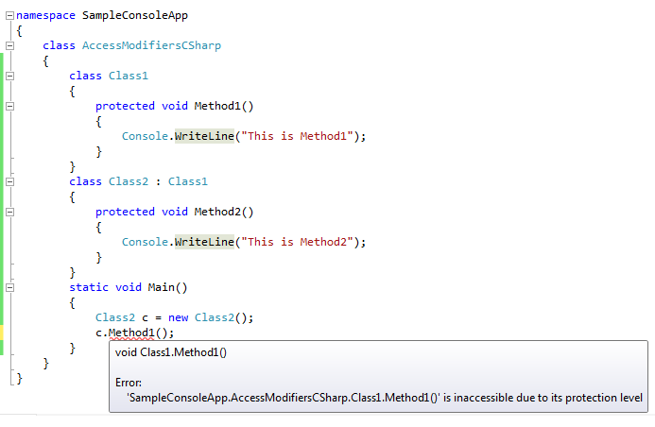
Code-Behind Event Handler
Method on Code-Behind Page
View

Slide 37
Data Binding in .Net MAUI

Slide 38
Binding to a Collection
Use “CollectionView” XAML control
Create a Service to populate collection from source (DB or Mock)
In VM, declare a variable to hold instance of Service
Instantiate Service in VM Constructor
Use VM “Init()” method to run Service method that populates data

Slide 39
Example 1 Collection View
<ContentPage...>
<Grid
RowDefinitions="*,50">
<CollectionView
Grid.Row="0"
ItemsSource="{Binding Students}">
<CollectionView.ItemTemplate>
<DataTemplate
x:DataType="model:Student">
<Grid
ColumnDefinitions="*,30">
<Label
Grid.Column="0"
Text="{Binding Name}" />
<Image
Grid.Column="1"
Source="checkmark.png"
IsVisible="{Binding IsRegistered}" />
</Grid>
</DataTemplate>
</CollectionView.ItemTemplate>
</CollectionView>
<Button
Grid.Row="1"
Text="Update Data"
Command="{Binding UpdateRegistrationsCommand}" />
</Grid>
</ContentPage>

